Slide 1
A short introduction to the PHP Code Service (PCS)
François Laupretre <francois@php.net>

Slide 2
What is PCS ?
A PHP extension
A service for other extensions (‘clients’)
It allows extensions to program part or all of their code in PHP

Slide 3
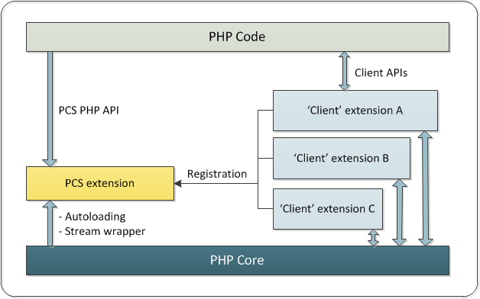
PCS architecture

Slide 4
Interactions
Script registration is the essential interaction
Happens at MINIT time
In most case, no interaction between client extensions and PCS after MINIT

Slide 5
Services
Handles script autoloading
Provides a ‘pcs://’ virtual tree to access non-autoloaded files
Exposes a thin PHP API for special cases, introspection, and completeness

Slide 6
Key benefits
Adding PHP code to an extension is very easy
Autoload preserves performance
Class names extraction from PHP code at registration time
In most cases, no interaction after MINIT
Supports embedded and/or external file trees

Slide 7
TODO / Roadmap
Compatibility with opcache
Extend autoload to functions and constants (?)
Create a PHP introspection API in Reflection
Include in the PHP core distribution (7.1 ?)

Slide 8
Want more ?
http://pcs.tekwire.net

